Slide 1
Introduction to Artificial Intelligence IICT Lecture 11

Slide 2
Intelligence
A very general mental capability that involves the ability to reason, plan, solve problems, think abstractly, comprehend complex ideas, learn quickly and learn from experience. [1]
Measurement of Intelligence:
Intelligence Quotient (IQ)
An intelligence quotient or IQ is a score derived from a set of standardized tests developed to measure a person's cognitive abilities ("intelligence") in relation to their age group
[1] Mainstream Science on Intelligence reprinted in Gottfredson (1997). Intelligence p. 13

Slide 3
Types of Dataset
Numerical:
The term “numerical data set” refers to a collection of data that exclusively contains numbers. This type is also known as a quantitative data set.
A person’s height and weight, or interior living space measurements are all examples of numerical data sets. Many financial analysis approaches rely on numerical data sets as well.
Categorical:
Categorical data sets contain information about the characteristics of a person or an object. This is known as qualitative data sets.
In a dichotomous data set, each variable can only have one of two values. A data set containing true or false.
In a polytomous data collection, each variable may have more than two possible values.
[1] Mainstream Science on Intelligence reprinted in Gottfredson (1997). Intelligence p. 13

Slide 4
Machine Learning
Machine learning focuses on the development of computer programs that can access data and use it to learn for themselves.
Machine learning is a subset of AI which allows a machine to automatically learn from past data without programming explicitly.

Slide 5
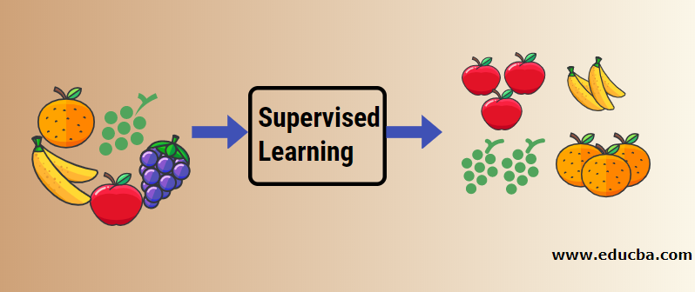
Supervised Learning
Definition:
Supervised learning, also known as supervised machine learning, is a subcategory of machine learning and artificial intelligence. It is defined by its use of labeled datasets to train algorithms that to classify data or predict outcomes accurately.

Slide 6
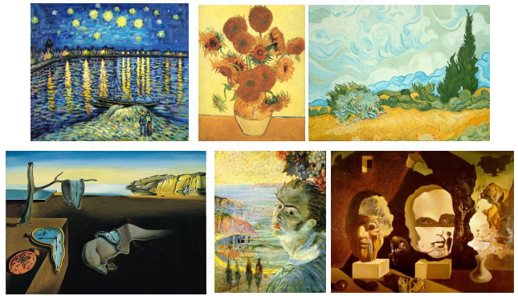
Painting by two different painters: Supervised Learning
Painter A
Painter B

Slide 7
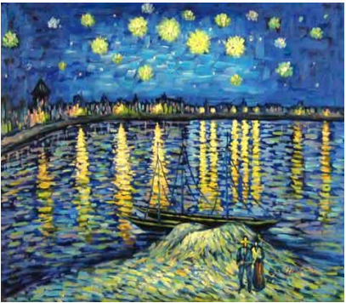
Now your turn… Who’s painting is this?

Slide 8
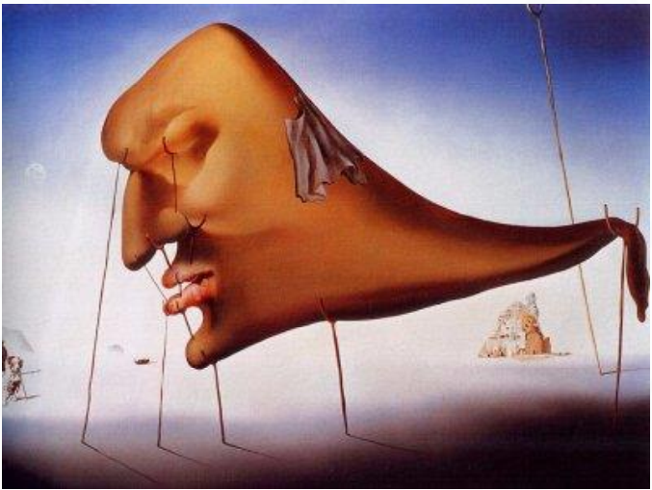
And this?

Slide 9
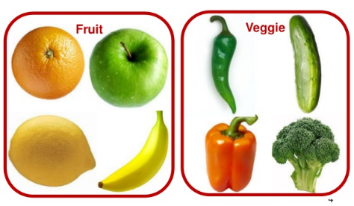
Unsupervised Learning
Definition
Where a program, given a dataset, can automatically find patterns and relationships within the dataset.
Clustering or grouping of like data.

Slide 10
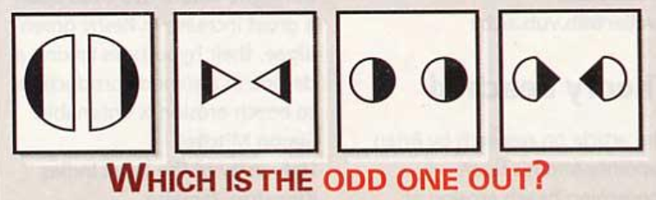
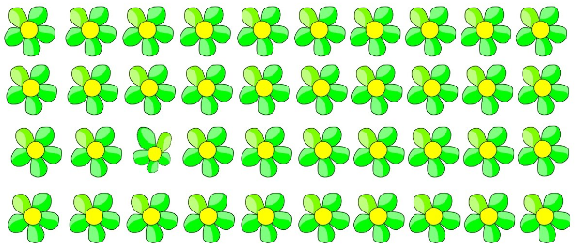
Finding the odd one out: Unsupervised Learning

Slide 11
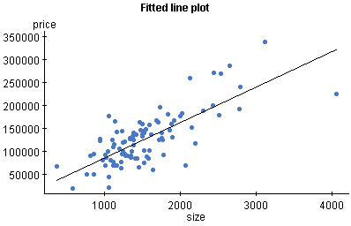
Regression
Sub-category of Supervised Learning
Regression is a type of algorithm that predicts a continuous values
Plot prices with relative to increase in area

Slide 12
Classification
Classification is a supervised machine learning method where the model tries to predict the correct label of a given input data.
In classification, the model is fully trained using the training data, and then it is evaluated on test data before being used to perform prediction on new unseen data.

Slide 13
Supervised vs Unsupervised
Parameters | Supervised machine learning | Unsupervised machine learning
Input Data | Algorithms are trained using labeled data. | Algorithms are used against data that is not labeled
Computational Complexity | Simpler method | Computationally complex
Accuracy | Highly accurate | Less accurate
No. of classes | No. of classes is known | No. of classes is not known
Data Analysis | Uses offline analysis | Uses real-time analysis of data
Algorithms used | Linear and Logistics regression,KNN Random forest, multi-class classification, decision tree, Support Vector Machine, Neural Network, etc. | K-Means clustering, Hierarchical clustering, Apriori algorithm, etc.

Slide 14
Supervised vs Unsupervised
Parameters | Supervised machine learning | Unsupervised machine learning
Output | Desired output is given. | Desired output is not given.
Training data | Use training data to infer model. | No training data is used.
Complex model | It is not possible to learn larger and more complex models than with supervised learning. | It is possible to learn larger and more complex models with unsupervised learning.
Called as | Supervised learning is also called classification. | Unsupervised learning is also called clustering.
Example | Example: Optical character recognition. | Example: Find a face in an image.

Slide 15

Planning: Knight’s Plight Can we move the given knight to the “Target” location?
Target

Slide 16
Planning: Knight’s Plight Can we move the given knight to the “Target” location?
Target

Slide 17
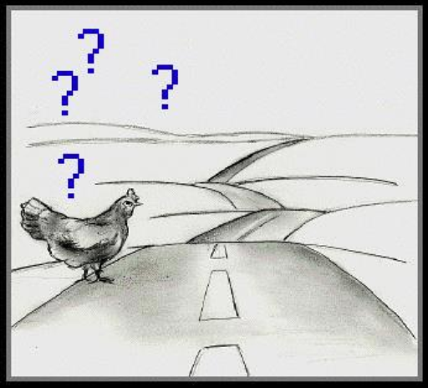
Some more…
What is the next number in this series?
1, 1, 2, 3, 5, ?
Would you cross a road when a fast car is approaching?

Slide 18

Conclusion
These are the very characteristics of Intelligent beings!!
Searching for a solution is central to intelligence
Knight’s Plight
Planning
Finding the odd one out
Unsupervised Learning
Painting by two different painters
Supervised Learning
Series Completion
Prediction
Road Crossing
Rational Actions
Process of Writing this Conclusion
Summarizing, Abstraction

Slide 19
What is Artificial Intelligence?
Computers are ______.
Making a machine (computer) to perform the same tasks which you have just done is called______.
Artificial Intelligence
If you learn to do these tasks using existing data, then this is called _____.
Machine Learning
Dumb

Slide 20
Artificial Intelligence
Artificial Intelligence has many subfields. For example, machine learning, natural language processing, computer vision, big data, data mining, robotics, etc.
Many of these subfields have a huge overlap.

Slide 21
CAPTCHA
USES:
Preventing Comment Spam
Preventing Automated Registrations
Protecting online voting/polls.

Slide 22
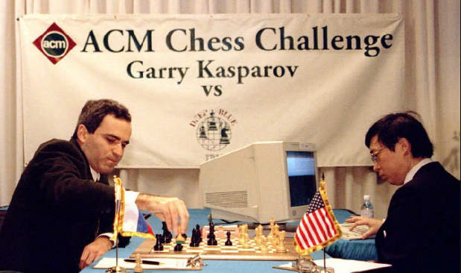
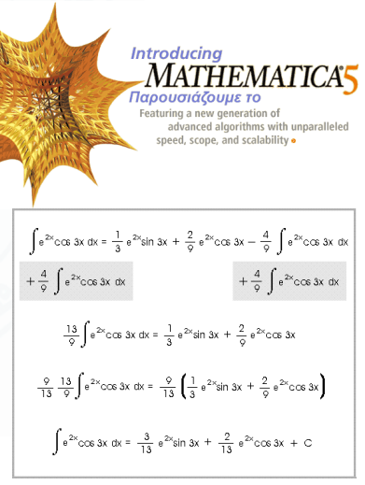
Is AI intelligent?
Planning
Kasparov Vs. IBM Blue (1997)
Calculation
Symbolic Integration in Mathematica
Theorem Provers

Slide 23
Natural Language Processing
A branch of AI
The man tried to take a picture of a man with a turban.
Did the man try to take a picture with a turban, or
take a picture of a man who is wearing a turban?
The man saw the boy with the telescope
Communicating in natural language assumes world knowledge and the understanding of context, both of which are required to resolve the ambiguities

Slide 24
Natural Language Processing
Google Now, Apple’s Siri, Microsoft’s Cortana, Amazon Alexa, etc. are examples of natural language processing.
They help to find useful information when we ask for using speech.
They can also perform other tasks when you ask, such as setting the alarm, making a phone call, etc.

Slide 25
Computer Vision
A branch of AI that enables computer to understand the content of images and videos.
Applications:
Optical character recognition (OCR)
Traffic Rule Violation
Object Detection and Recognition

